Slide 1
CSET301 (AI-ML)
Lecture 27: Convolutional Neural Networks and Image classification
Deepika Vatsa

Slide 2
Outline
Computer vision tasks
Brief introduction to CNN
Problems of using ANN for image processing
Convolution operation, Padding, Pooling, Striding
CNNs vs ANNs
Image classification using CNN: AlexNet
Notes:
Convolution operation: key and fundamental building block of CNN

Slide 3

Computer Vision tasks
3
Notes:
Since CNNs can perform analysis on image and visuals, these can be used for any computer vision tasks like:
Image recognition and Image classification
Object detection
Recognition of faces, etc.
CNN takes an image as an input, processes it, and classifies it under certain categories.

Slide 4

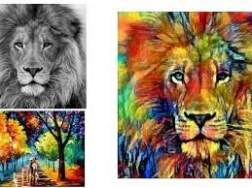
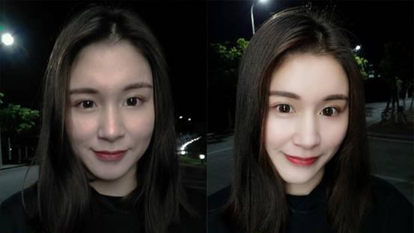
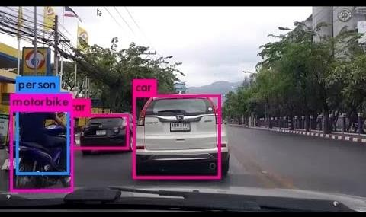
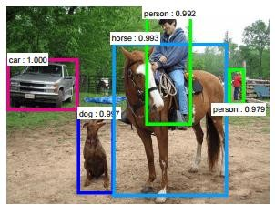
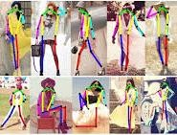
Style Transferring
Computer Vision Tasks
Face Recognition
Image quality enhancement Beautification
Object detection (Self driving car)
Classification
Gesture Recognition
Notes:
Computer vision tasks.
Face recognition, all of us are familiar with this, this features is available on our mobile phones where we can unlock the phone using our face
Object detection: Task is to detect the object and its position. If we are building a self driven car, we need this feature in our car to detect the nearby objects accurately. Objects are detected by drawing boxes around them. Boxes help in recognizing where in the picture are these objects.
Style transfer is where you have an image and want to restyle it, so the below image shows the style, and the original image is styled by sec image.
One major problem with computer vision problems is that the input data can get really big.

Slide 5
Convolutional Neural networks
A Convolutional neural network (CNN, or ConvNet) is a type of neural network that can be used to perform analysis on visuals.
5

Slide 6
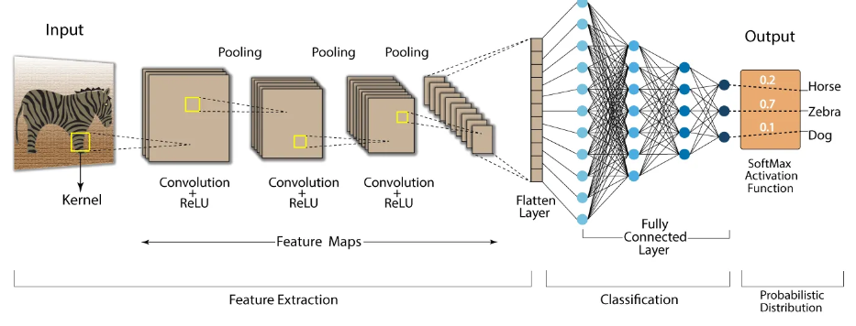
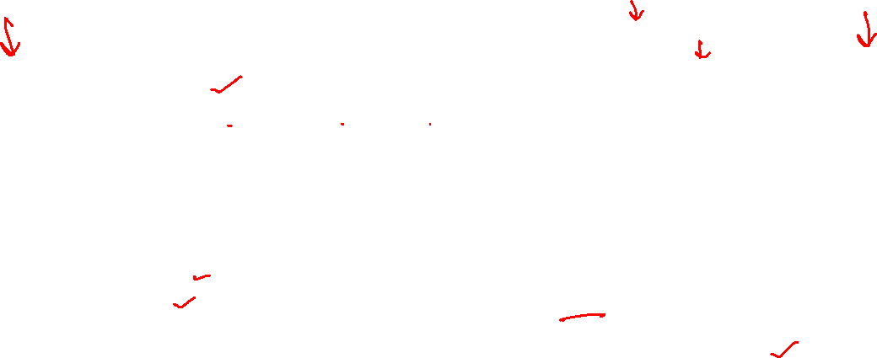
Image classification using CNN

Slide 7

Problems of ANN for image processing
7
Notes:
So first we will see why it is not possible/feasible to use artificial neural networks for image processing.

Slide 8
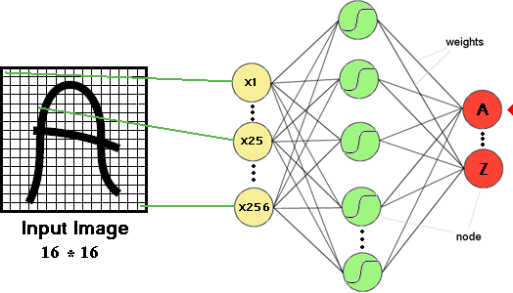
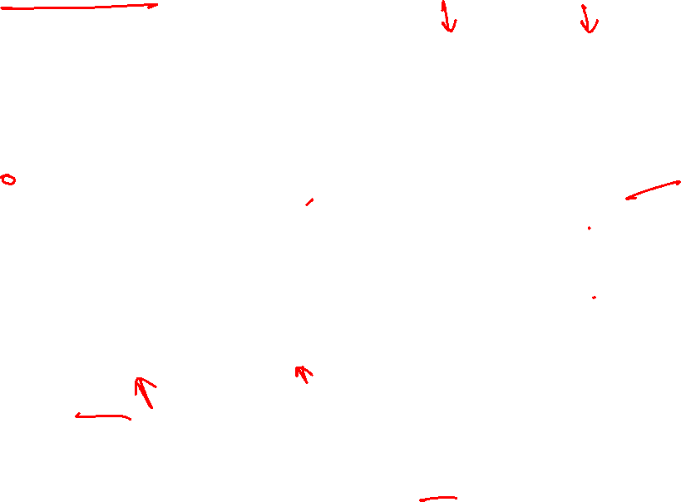
Multi-layer perceptron and image processing
8
Notes:
Lets say we have this 16x16 image for the task of alphabet recognition.
Lets see what happens when we feed this image to a multi-layer perceptron.

Slide 9
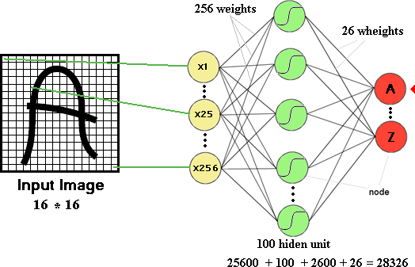
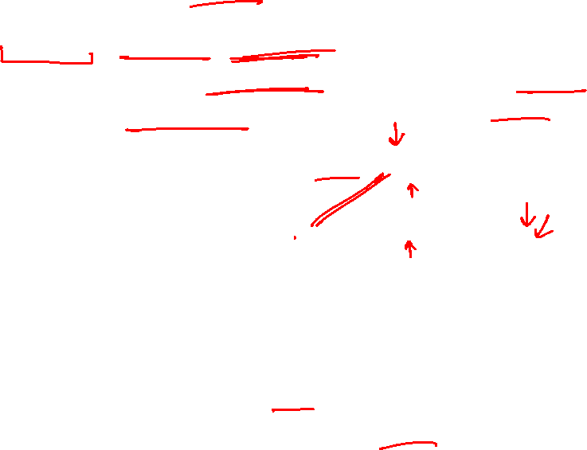
Even a simple 16x16 image
256 x 100 + 100 bias + 100 x 26 output neurons + 26 bias = 28326
The number of trainable parameters becomes extremely large
Require more computational and memory requirements
9
Notes:
16 x 16 image. Let each pixel is an input, therefore 256 inputs / xs’.
Let the hidden layer has 100 neurons, so there will be 25600 weights Plus 100 biases
The final output layer has 26 output neurons, each representing an alphabet.
So there will be 2600 weights + 26 biases
Adding all together, we have 28326 different parameters to learn which is so difficult.
And this is the case with a simple image of 16x16 when in reality we have mages like 720x720x3 (3 channels).
With so many parameters, it is difficult to get so much data to prevent NN from overfitting. And this will result in more computational and memory requirements– not something most of us can deal with. Thus using multi-layer perceptron does not seem like a feasible model.

Slide 10
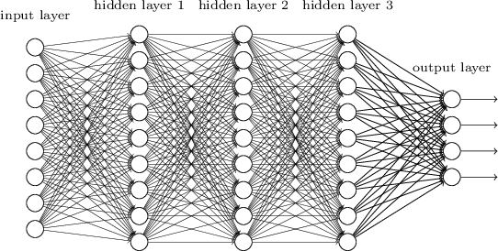
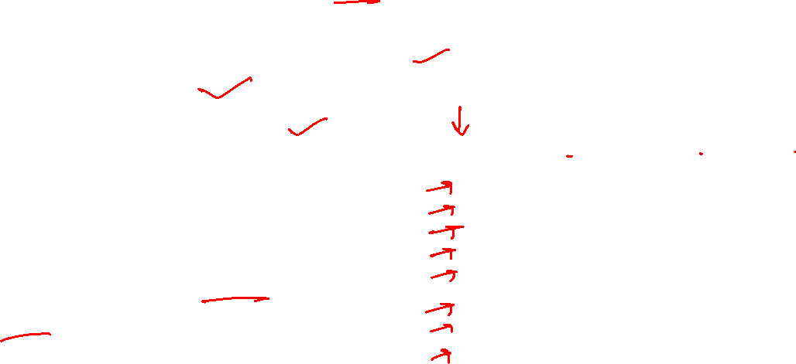
Problems with Fully connected NN
Fully connected (FC) network: Dense connections
Too many parameters/weights to learn
Prone to overfitting
Vanishing gradient problem
Fully connected NN is good to learn a small model
Notes:
4. Some gradients might vanish due to long chains. Since the network is very deep, the gradients in the few of the starting layers
might get vanished when flowing back and therefore resulting in no training of the weights.

Slide 11
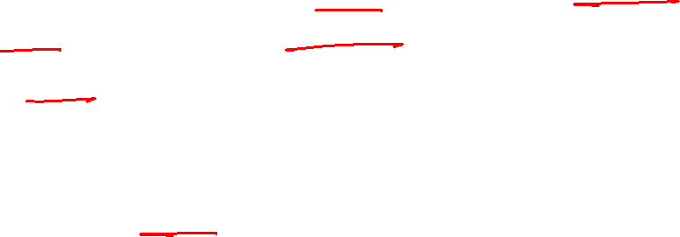
Objective
The objective is to have a network that is a complex network (having non-linearities) but has fewer parameters and is, therefore, less prone to overfitting.
Convolutional Neural Network (CNN) belong to the family of networks that serves this objective.

Slide 12
Convolution operation
Convolution means applying filters to the input to create a feature map
12

Slide 13
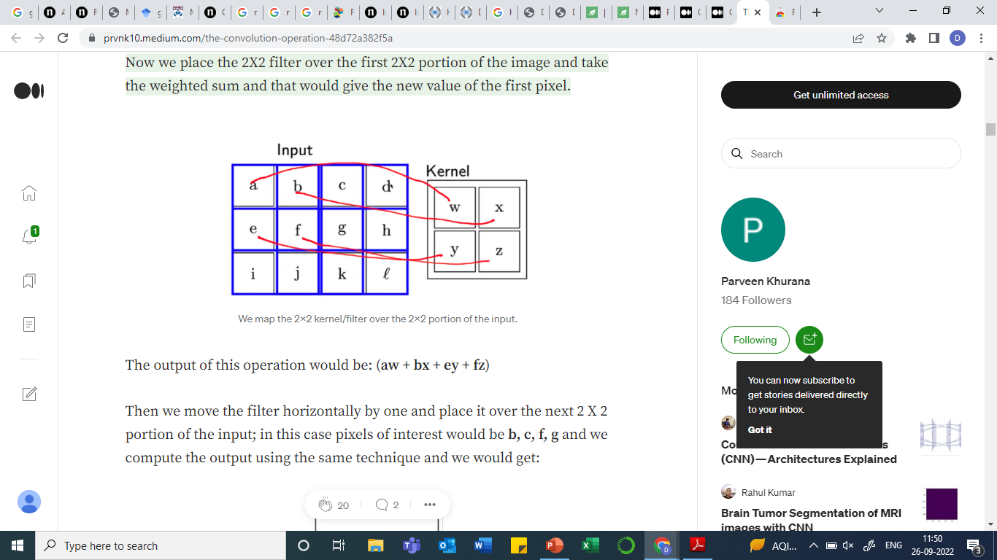
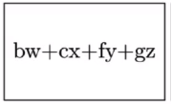







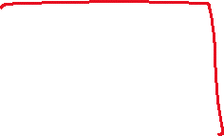

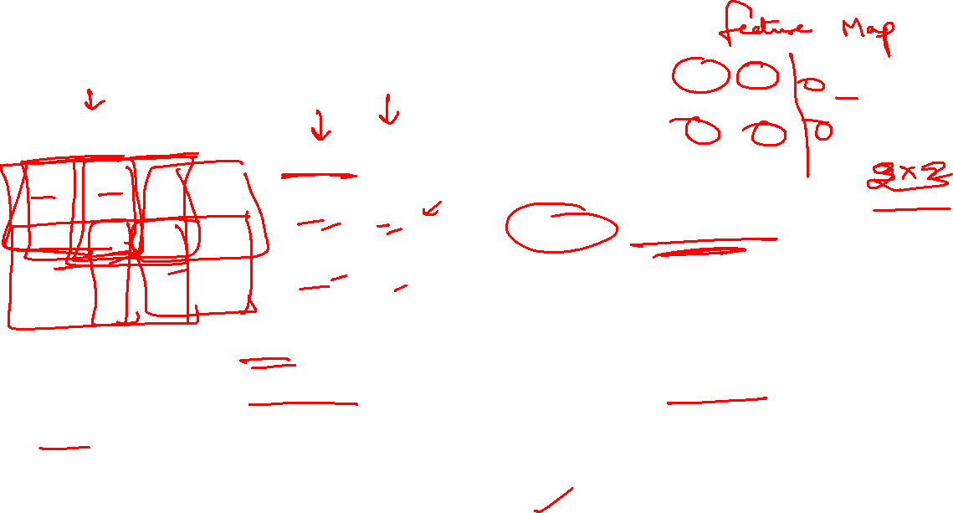
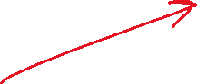

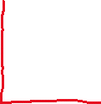

Convolution Operation
Output: (aw + bx + ey + fz)
Move the filter horizontally by one and place it over the next 2 X 2 portion of the input; in this case pixels of interest would be b, c, f, g and weighted sum is:
Notes:
To solve these problems we have CNN, before we start with CNN, lets understand what is convolution?
Kernel or weights or filter or convolution mask, same thing
Using a filter smaller than the input is intentional as it allows the same filter (set of weights) to be multiplied by the input array multiple times at different points on the input. Allows the filter an opportunity to discover that feature anywhere in the image

Slide 14
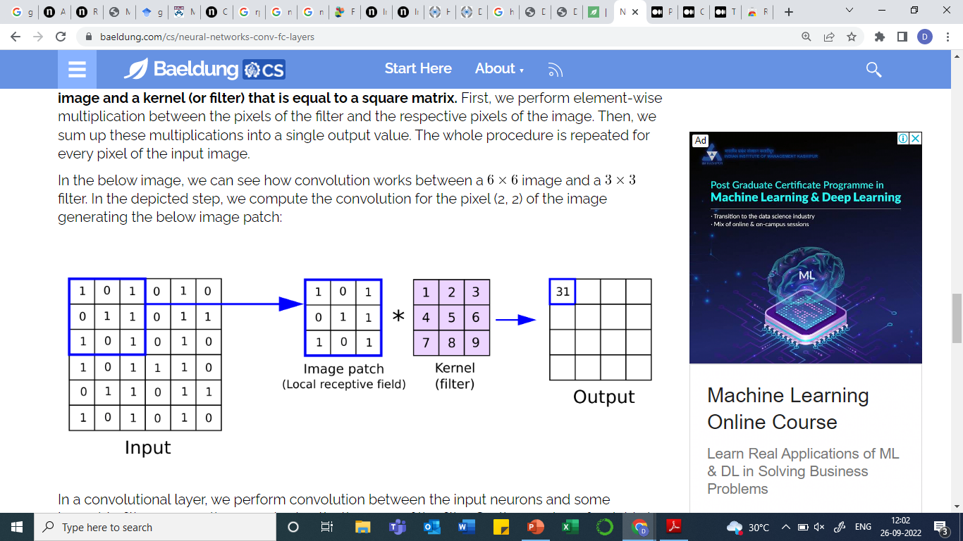
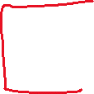

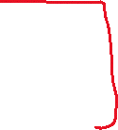
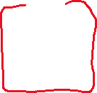
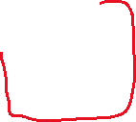
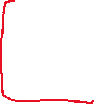
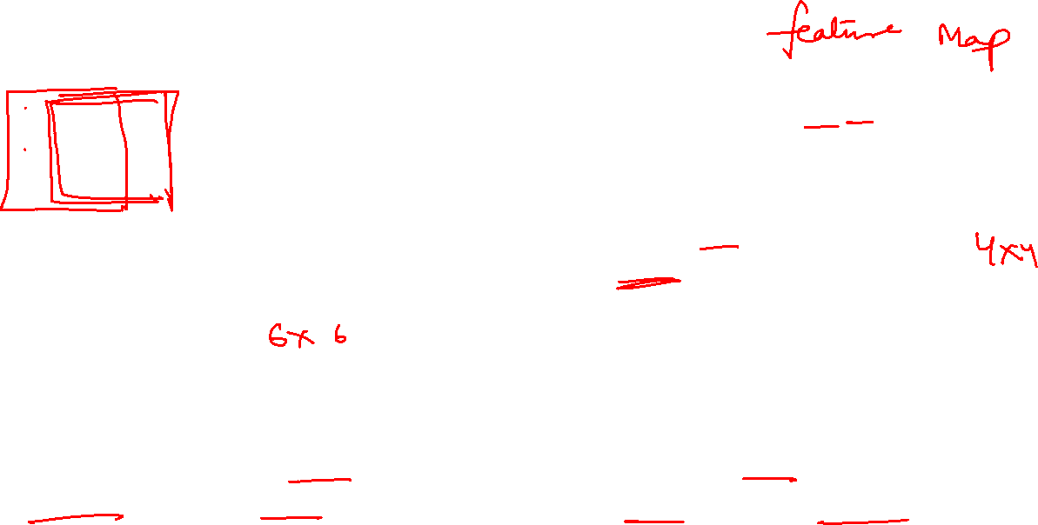





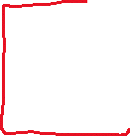

Convolution Operation
The output is called a feature map.
Once a feature map is created, we can pass each value in the feature map through a nonlinearity, such as a ReLU, much like we do for the outputs of a fully connected layer.

Slide 15
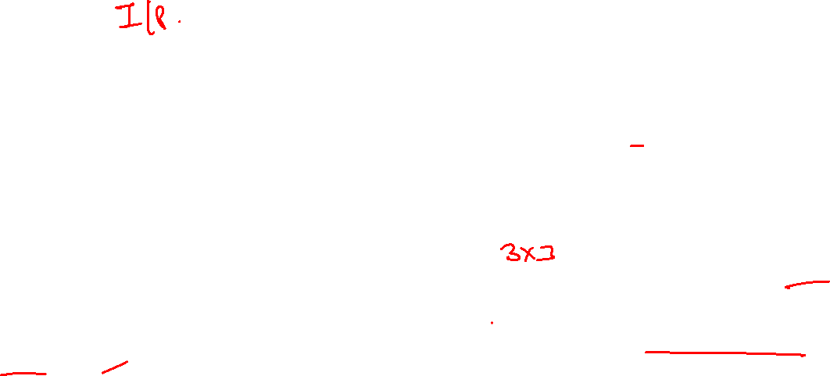
Convolution Operation: Example
convolution (dot product)
3 1 | 0 0 | 1 -1 | 2 | 7 | 4
1 1 | 5 0 | 8 -1 | 9 | 3 | 1
2 1 | 7 0 | 2 -1 | 5 | 1 | 3
0 | 1 | 3 | 1 | 7 | 8
4 | 2 | 1 | 6 | 2 | 8
2 | 4 | 5 | 2 | 3 | 9
-5 | -4 | 0 | 8
1 | 0 | -1
1 | 0 | -1
1 | 0 | -1
=
*
3 x 3 Filter (f x f)
4 x 4 ((n – f + 1) X (n – f + 1))
6 x 6 Matrix (n x n)
Notes:
Lets take a 6x6 grayscale image. (grayscale=one channel)
This 3x3 is a filter/kernel
Asterisk sign is convolution operation. We convolve this filter on the 6x6 matrix.
The output is 4x4 matrix.
-5 is computed as by taking the element-wise product of first window and filter and add them all.

Slide 16
Convolution Operation: Example
Convolution operation
3 | 0 1 | 1 0 | 2 -1 | 7 | 4
1 | 5 1 | 8 0 | 9 -1 | 3 | 1
2 | 7 1 | 2 0 | 5 -1 | 1 | 3
0 | 1 | 3 | 1 | 7 | 8
4 | 2 | 1 | 6 | 2 | 8
2 | 4 | 5 | 2 | 3 | 9
-5 | -4 | 0 | 8
1 | 0 | -1
1 | 0 | -1
1 | 0 | -1
=
*
3 x 3 Filter (f x f)
4 x 4 ((n – f + 1) X (n – f + 1))
6 x 6 Matrix (n x n)
Notes:
To find the second element in the output matrix, we slide the window on the first image to the right by one column and convolve.
Convolving an input of 6 X 6 dimension with a 3 X 3 filter results in 4 X 4 output
In python, the function to do convolution is : conv_forward
In tensorflow: tf.nn.conv2d

Slide 17
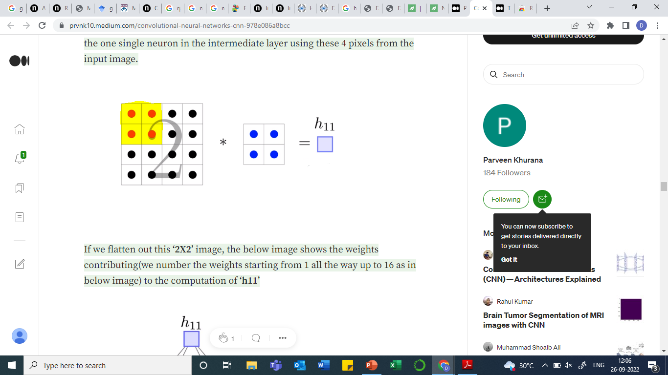
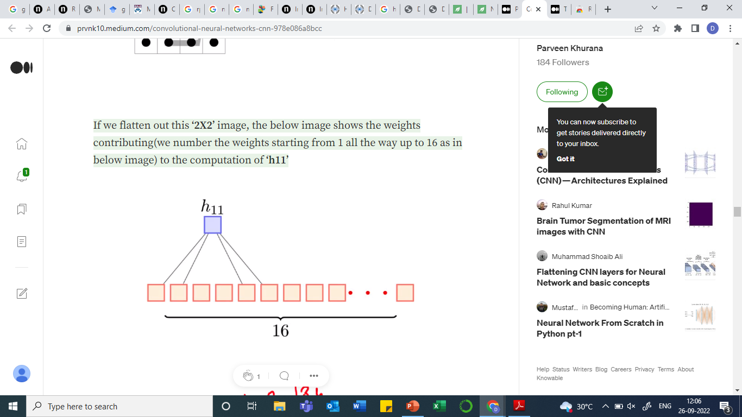

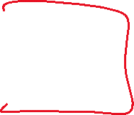

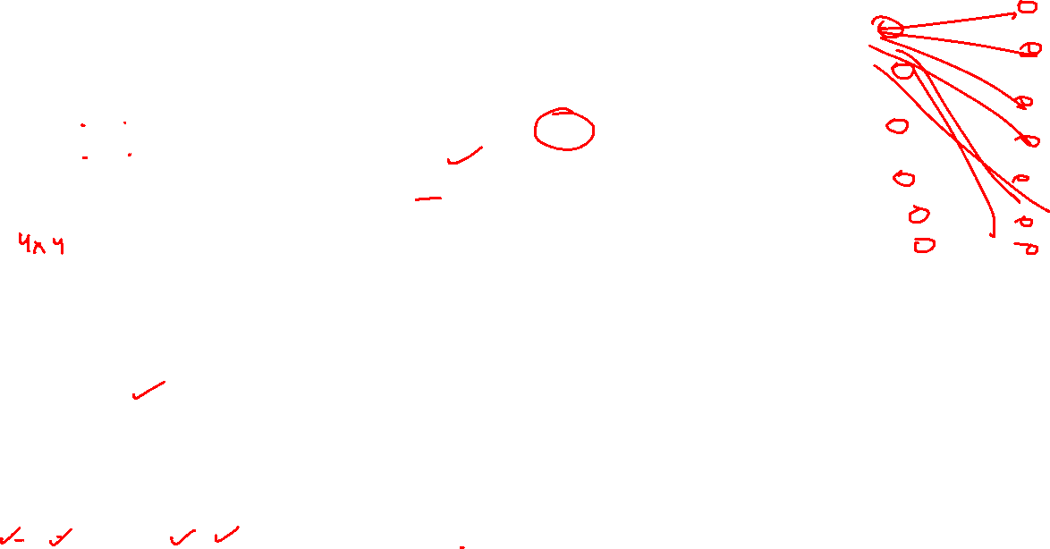



Convolution Operation
If we flatten out this ‘4X4’ input image, we get the below image
So, ‘h11’ is computed using 4 values instead of taking all the 16 values into consideration.
Or the other way to look this is that all the 16 values are taken into consideration however the weights associated with the 12 values are 0 and in effect, we are left with only 4 values which contribute to the output.
Notes:
This output will be the intermediate layer values

Slide 18
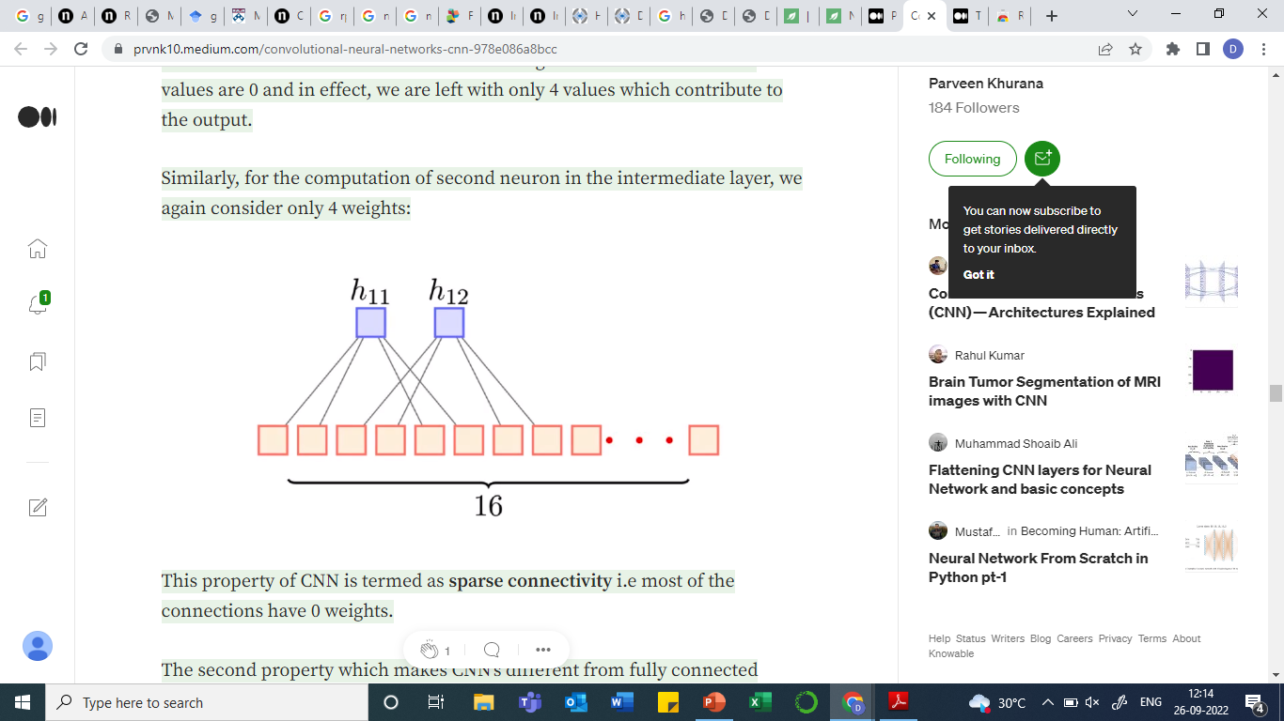

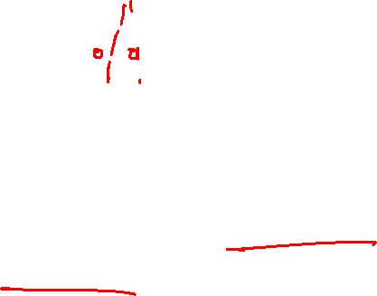
Convolution Operation
Similarly, for the computation of second value, we again consider only 4 weights:
This property of CNN is termed as sparse connectivity i.e., most of the connections have 0 weights.

Slide 19
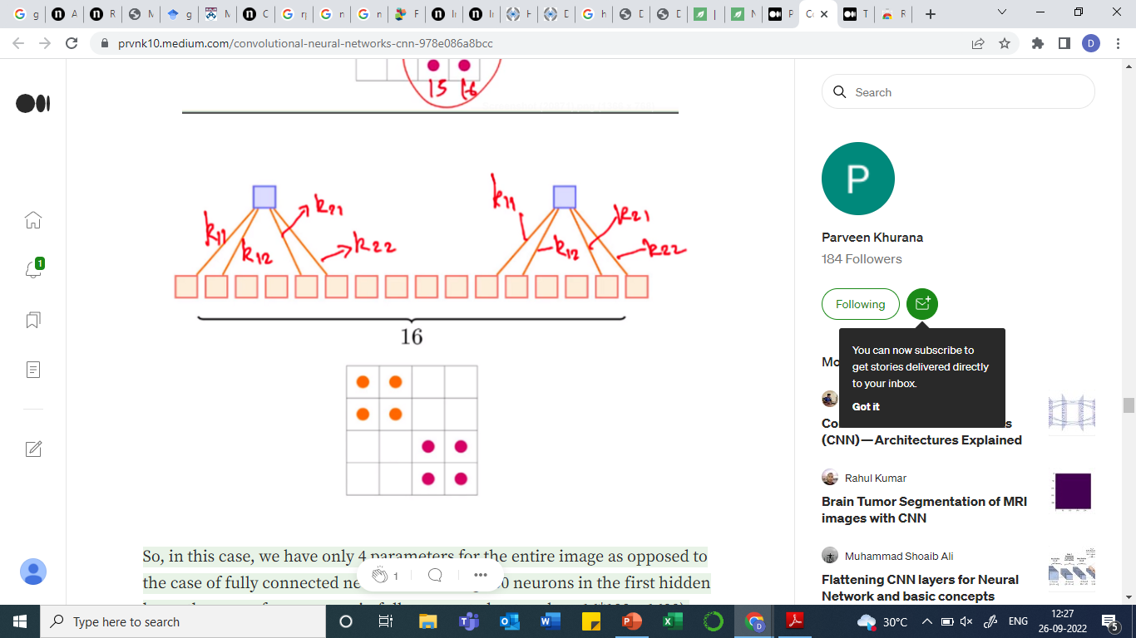
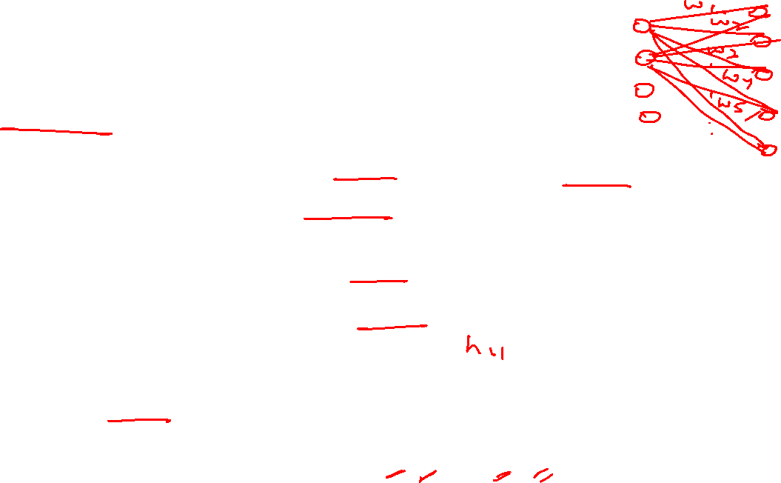
Convolution Operation
Weight sharing:
The second property which makes CNN’s different from fully connected neural networks is that CNN’s use weight sharing:
Weights are the numbers within each filter.
So essentially, we are trying to learn a filter.
These filters act on small sections of the image.
The same kernel/filter is used to find the outputs (the same filter is sliding horizontally and vertically)

Slide 20
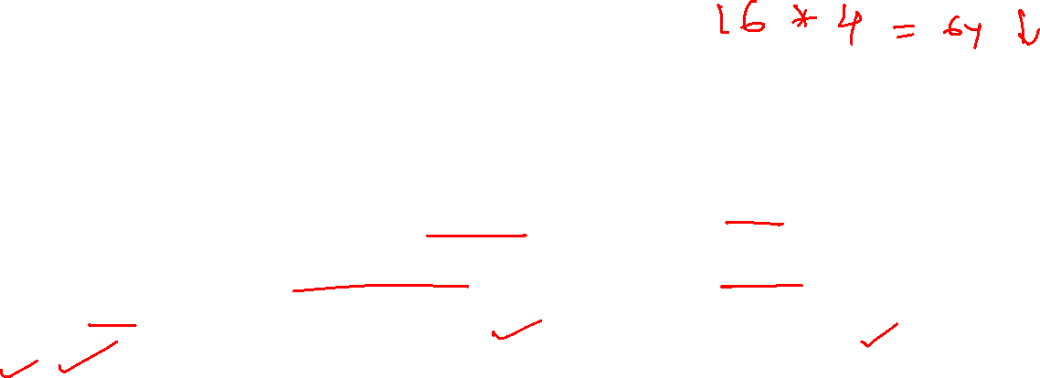
Convolution Operation
Weight sharing
So, in this case, in CNN, we have only 4 parameters for the entire image.
As opposed to the case of fully connected network (assuming 100 neurons in the first hidden layer, then no. of parameters in fully connected network => 16*100 = 1600).
Notes:
This output will be the intermediate layer values

Slide 21
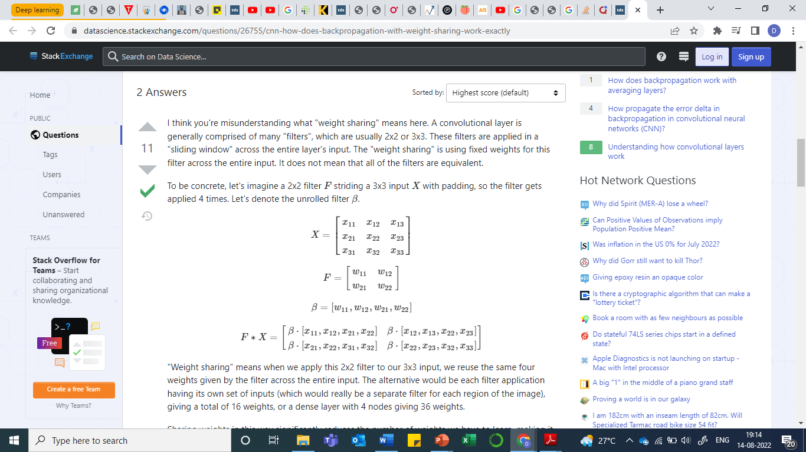




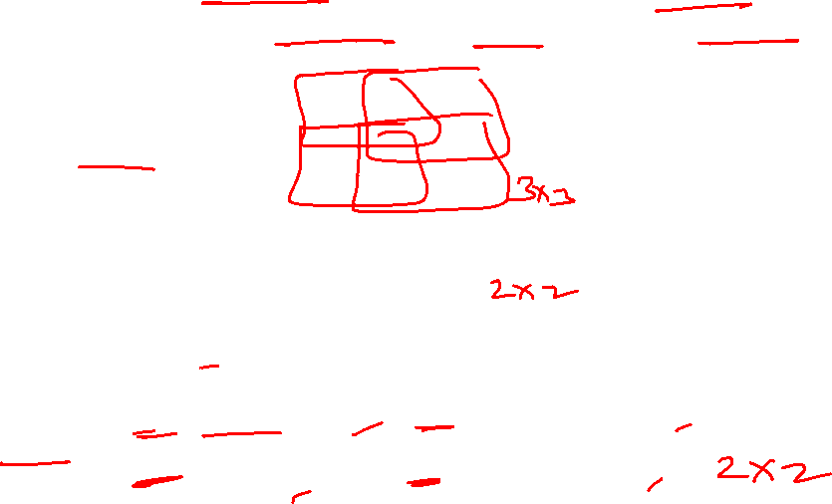
Weight Sharing in CNN
The filter is applied in a "sliding window" across the entire layer's input.
The "weight sharing" is using fixed weights for this filter across the entire input.
Notes:
"Weight sharing" means when we apply this 2x2 filter to our 3x3 input, we reuse the same four weights given by the filter across the entire input.
Unrolling F to beta, it is just four weights.
F*X denoting convolution is just applying these weights on our input image four times.
The alternative would be each filter application having its own set of inputs (which would really be a separate filter for each region of the image lets say beta1, beta2, beta3, beta4), giving a total of 16 weights, or we can visualize it as having a dense layer with 4 nodes giving 36 weights.
So using CNN, we have reduced the num of weights from 9 (ANN) to 4(CNN).

Slide 22
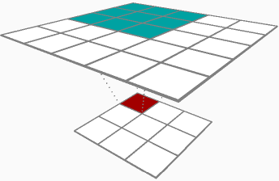




Weight Sharing in CNN
The "weight sharing" is using fixed weights for this filter across the entire input.
Notes:
Sharing weights in this way significantly reduces the number of weights we have to learn, making it easier to learn very deep architectures, and additionally allows us to learn features that are agnostic to what region of the input is being considered.
Here we see a 3x3 filter convolving over a 5x5 image, and the filter weights illustrated by the green/blue window show the same weights are used. Only 9 weights are needed to be learned

Slide 23
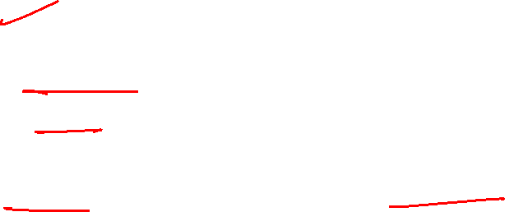
Convolution Neural Network (CNN)
Two Properties:
CNNs have sparse connectivity: For each layer, each output value depends on a small num of inputs, instead of all inputs
CNNs use weight sharing: Single filter convolved over the entire image

Slide 24
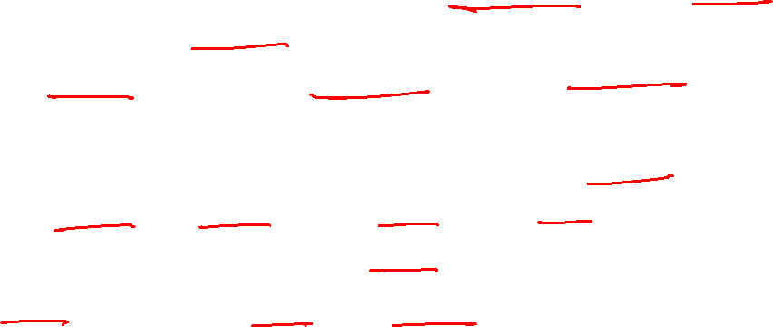
Convolution Neural Network (CNN)
Primary purpose of convolution in CNN is to extract features from the input image.
Matrix formed by sliding the filter over the image and computing the dot product is called the ‘Convolved Feature’ or ‘Activation Map’ or the ‘Feature Map’.
So we use convolution matrix/mask/kernel/filter in image processing for variety of tasks such as blurring, edge detection, sharpening, embossing, etc.
Each convolution filter extract some kind of feature
We apply 3x3 filter on grayscale image and 3x3x3 on colored image.

Slide 25
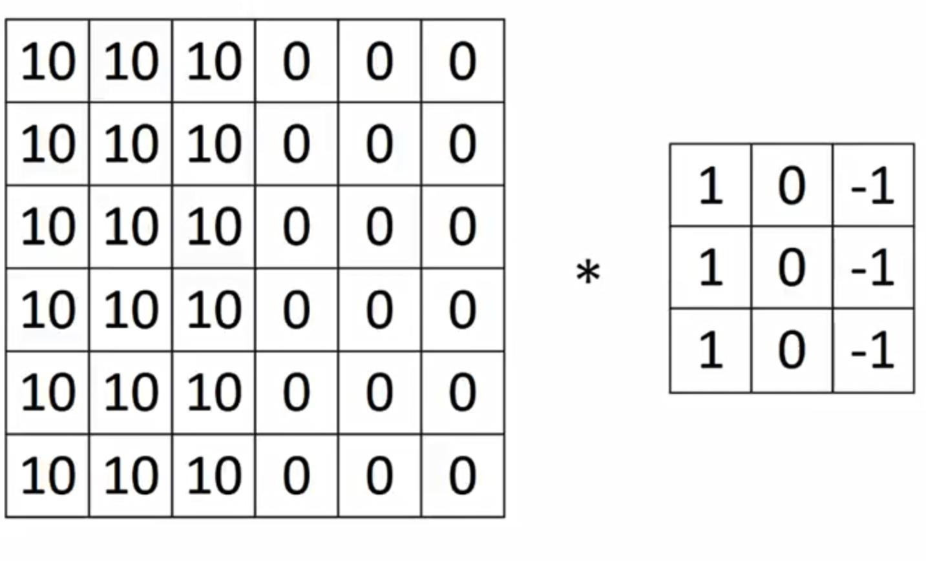
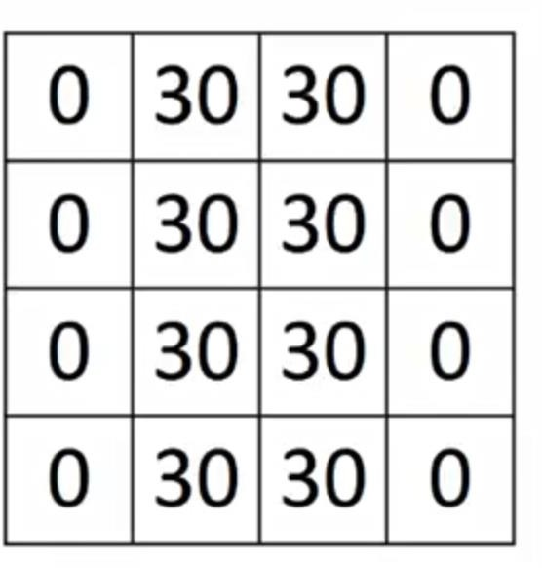
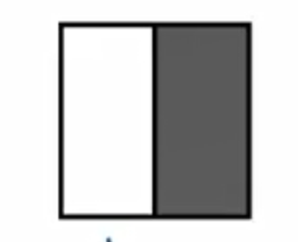
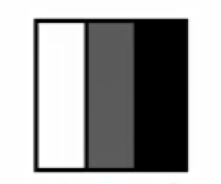
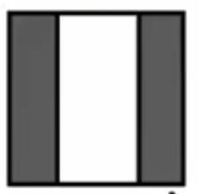





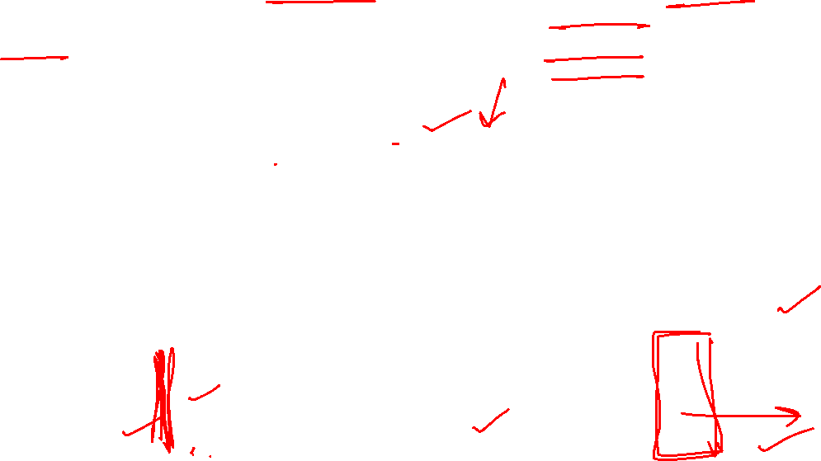


Feature extraction using convolution: Detecting Vertical edges
6*6 = 36
4*4=16
In case of ANN # parameter to train = 36*16 = 576
In case of CNN # parameter to train = 9
Notes:
Here 6x6 matrix looks like the image below where half is white (brighter intensity values) and the second is grey (darker intensity values)
We can say that in the middle of white and gray is an edge, which lets transition from white to gray
The 3x3 filter used here is used to detect vertical edges in an image. This filter is known as vertical edge detector filter.
Similarly, the 3x3 filter can be visualized like this. So we have taken this matrix to detect edges, so basically, bright pixels on the left, no matter what is in the middle, and then dark pixels on the right.
After convolution, we get the matrix on the right. The right matrix can be visualized as the image below clear shows the edge in the middle.
Here we have used a small image, but if we take a large image, and you experiment with it to find the vertical edges, you see, it is doing a good job.
And it doesnot matter, if we have dark pixels on the left and white on the right in the image, we will still be able to detect the edges. (Try it out by swapping 10s on the right and 0s on the left and then apply convolution filter, you will get the same output result.). So basically, whenever there is a transition from light to dark or vice-versa, this filter can detect the edge.

Slide 26
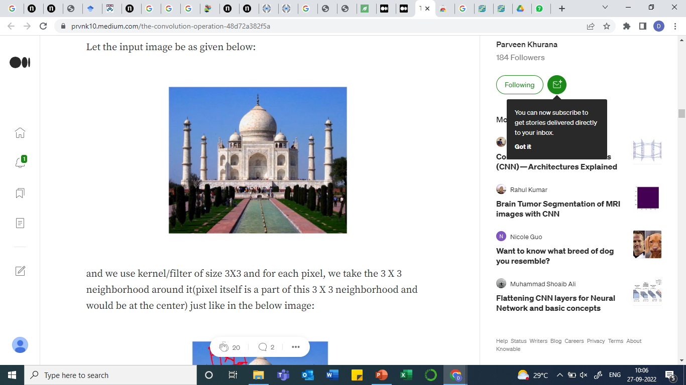








Feature extraction using convolution
Notes:
Blurring the image:
Since all the weights are 1/9 that means the re-estimated value of each and every pixel would be 1/9th of its original value. This kernel is taking the average of all the 9 pixels over which this kernel would be placed.
That means for each pixel/color in the image, if we take the average (divide the weighted sum value by 9), it would dilute the value/blurs the image and the output we get by applying this convolutional operation is:
Sharpening image:
we are using 5 as the weight for the central pixel and 0 for the all the boundary pixels and -1 for the remaining pixels, so the net effect would be that the value/color intensity of the central pixel is boosted and its neighborhood information is getting subtracted so the result of this is that it sharpens the image.

Slide 27

Why 3x3 Convolution filters?
Usually, 3x3 or 5x5 size is taken for convolution filters.
1. Most of the features in an image are usually local. Therefore, it makes sense to take a few local pixels at once and apply convolutions.
2. Most of the features may be found in more than one place in an image. This means that it makes sense to use a single kernel all over the image, hoping to extract that feature in different parts of the image.
3. The number of parameters grows quadratically with kernel size. This makes big convolution kernels not cost-efficient enough.
4. By limiting the number of parameters, we are limiting the number of unrelated features possible.

Slide 28






Feature learning
Would the model be able to learn the features using a single filter and perform well on training and test set?
No, we use multiple filters to capture multiple representations of the input (say 1 filter capturing edges, 1 filter for the purpose of sharpening the input and so on). Let’s say we use 100 filters of size 2X2, so the total number of parameters would be 100*4 = 400 which is not bad as we would have many such intermediate layers and each layer would have its own set of weights.
Notes:
While training the CNN, we learn values of the filter, that is, weights.
The network will learn what types of features to extract from the input. Specifically, training under stochastic gradient descent, the network is forced to learn to extract features from the image that minimize the loss for the specific task the network is being trained to solve, e.g. extract features that are the most useful for classifying images as dogs or cats.

Slide 29

Feature learning
The innovation of CNNs is the ability to automatically learn a large number of filters in parallel specific to a training dataset.
For example, it is common for a convolutional layer to learn from 32 to 512 filters in parallel for a given input.
Notes:
While training the CNN, we learn values of the filter, that is, weights.
The network will learn what types of features to extract from the input. Specifically, training under stochastic gradient descent, the network is forced to learn to extract features from the image that minimize the loss for the specific task the network is being trained to solve, e.g. extract features that are the most useful for classifying images as dogs or cats.

Slide 30

Disadvantages of Convolution
1. Every time we apply a convolutional operation, the size of the image shrinks
2. Pixels present in the corner of the image are used only a few times during convolution as compared to the central pixels. Hence, we do not focus too much on the corners.
To overcome these issues, we use padding

Slide 31











Padding: Zeros are added to outside of the input
Padding helps in extracting information lying on the corners of a image.
In turn, it preserves the original dimensions of the input.
Number of zero layers depend upon the size of the kernel
Input n = 5x5
Padding p = 1
Filter f = 3x3
Output: (n+2p-f+1) x (n+2p-f+1)
5X5 image (with padding)
5X5
Notes:
This way we don’t lose a lot of information and the image does not shrink either.
Here applying 3x3 filter on 5x5 input with padding leads to 5x5 output. (Same dimension)
Application: Localization in object detection

Slide 32











Stride
Stride specifies the num of steps we take in horizontal and vertical directions separately by sliding the kernel.
E.g., Here, stride s = 3
1 | 0 | -1
1 | 0 | -1
1 | 0 | -1
2X2
3X3 Filter
Output: [(n+2p-f)/s+1] X [(n+2p-f)/s+1]
6X6 Matrix
Notes:
We do stride when the input image size is too big and we want smaller feature maps

Slide 33

















Channels
3x3x3 Filter
6x6x3 Matrix
Padding = 0, Stride = 1
So, the first element of the output is the sum of the element-wise product of the first 27 values from the input (9 values from each channel) and the 27 values from the filter
Notes:
If we consider a grayscale image, channel is 1
For RGB image, we have three channels.
Input is 3D
The filter is also 3D
The convolutional operation that we perform is 2D as we are sliding the filter horizontally and vertically and not along the depth
This is because the depth of the filter is the same as the depth of the input

Slide 34

Channels
Notes:
We can use multiple filters as well.
Let’s say the first filter will detect vertical edges and
the second filter will detect horizontal edges from the image.
If we use multiple filters, the output dimension will change. So, instead of having a 4 X 4 output as in the above example, we would have a 4 X 4 X 2 output (if we have used 2filters):

Slide 35

Putting it all together
If we use 3 different filters, we get 3 outputs corresponding to each filter.
We can combine these different outputs representations into one single volume.
After combining all of the representations we get the depth as well.
If we apply 100 filters to the input, we get the output of depth 100.

Slide 36

Putting it all together
Notes:
Nc determining the depth, the depth of input image and of filter will be the same.
Depending upon the num of filters we have applied, we get the output of same depth. If we apply 100 filters, we get output of depth 100.

Slide 37

One layer of Convolutional network
After convolving the filter over the entire image, we add a bias term to those outputs and finally apply an activation function to generate activations.
By default, Relu activation function is used after convolution operation.
The forward pass equation:
Input (6 X 6 X 3) is a^{[0]}
Filter (3 X 3 X 3) is w^{[1]}
These activations from layer 1 act as the input for layer 2, and so on
Notes:
We do not use any other activation function in CNN because tanh and sigmoid has vanishing gradient problem. While Relu does not have it.
We donot use relu at output layer, there we use sigmoid for binary classification task and softmax for multiclass classification tasks.

Slide 38
One layer of Convolutional network
In CNN, the number of parameters is independent of the size of the image.
It essentially depends on the filter size
Calculating num of parameters in one convolutional layer
Suppose there are 10 filters, each of shape 3 X 3 X 3.
Number of parameters for each filter = 3*3*3 = 27
There will be a bias term for each filter, so total parameters per filter = 28
As there are 10 filters, the total parameters for that layer = 28*10 = 280
No matter how big the image is, the parameters only depend on the filter size.

Slide 39

Convolutional Network
In a CNN, there are basically three types of layers:
1. Convolution layer
2. Pooling layer
3. Fully connected layer
Notes:
We have talked about convolutional layer, lets see pooling layer next

Slide 40
Pooling
The idea here is that one feature map (output after convolving input with the filter) captures the representation for the entire image (and is typical of the same size as the input if appropriate padding is applied) and to shrink the size of the feature map, we look at a particular neighborhood and whatever be the most active part (highest number) in that neighborhood we keep that.

Slide 41

Max Pooling
Max Pooling
Input size 4x4
Output size 2x2
Also known as sub-sampling
Max pooling selects the maximum element from the region covered by the filter.
Feature map contain the most prominent features

Slide 42

Average Pooling
Average Pooling
Input size 4x4
Output size 2x2
Avg pooling takes the average of the elements in the region covered by the filter.

Slide 43
Pooling
Benefits:
Reduces the dimensionality of feature map
Zoom-out
It speeds up computation
It makes invariant to some very small transformations of the data
It allows later convolutional layers to work on larger sections of the data because a small patch after the pooling layer corresponds to a much larger patch before it

Slide 44
Flattening
The process of converting a 2-d array into a vector is called Flattening.
After a series of convolution and pooling operations on the feature representation of the image, we then flatten the output of the final pooling layers into a single long continuous linear array or a vector.
Flatten output is fed as input to the fully connected neural network having varying numbers of hidden layers to learn the non-linear complexities present with the feature representation.

Slide 45
Fully connected layer
The input to the fully connected (FC) layer in the CNN represents the feature vector for the input.
The aim of the Fully connected layer is to use the high-level feature of the input image produced by convolutional and pooling layers for classifying the input image into various classes based on the training dataset.
Softmax activation function is used at the output layer.

Slide 46
Hyperparameters in CNN
Num of filters
Size of filters
Stride
Padding

Slide 47

Structure of CNN
Let x is the input data samples. To classify these samples with a NN, we simply connect them all to a fully-connected layer (F). There are a bunch of different neurons, and every input connects to every neuron.

Slide 48
Structure of CNN
In computer vision, we care about the local properties in image data like edges, texture, the contrast between two colors, etc.
And we care about these properties in all regions of image data
To look for local properties, we need to look at a small window of the image sample in order to determine them.

Slide 49

Structure of CNN
So, we create a group of neurons, A, that look at different regions of our data
A look at all such regions and compute certain features.
Then the output of this convolutional layer is fed into the fully-connected layer F
Notes:
Here for simplicity, we considered 1D data and A only looked at segments consisting of two points.

Slide 50

Structure of CNN
One very nice property of convolutional layers is that they’re composable.
We can feed the output of one convolutional layer into another.
With each layer, the network can detect higher-level, more abstract features.
Here we have a new group of neurons, B, used to create another convolutional layer stacked on top of the previous one.

Slide 51
Structure of CNN
A max-pooling layer takes the maximum of features over small blocks of a previous layer. The output tells us if a feature was present in a region of the previous layer, but not precisely where.
Max-pooling layers kind of “zoom-out”.
They allow later convolutional layers to work on larger sections of the data because a small patch after the pooling layer corresponds to a much larger patch before it.
They also make us invariant to some very small transformations of the data.

Slide 52

Structure of CNN

Slide 53


Structure of 2D CNN
In 2D CNN, instead of looking at segments, A will look at patches.

Slide 54
Structure of 2D CNN
A is a bunch of neurons that all get the same input and compute different features.
For e.g., one neuron might detect vertical edges, another neuron detects horizontal edges, and another might detect red-green color contrast, etc.

Slide 55
Training CNN
In Feed Forward NN (or fully connected NN):
We pass the input through all the layers of the network and compute the final output. Based on this final output, we compute the loss value and then we take the derivative of the loss function with respect to the parameters of the model and update the parameters accordingly in a way that the overall loss is minimized.
CNNs can be implemented as a feed-forward NN where only a few weights are active, we can consider the weights associated with the rest of the neurons to be 0. When we backpropagate the loss function, we will only update the weights in the network which are not zero and this will continue throughout the training.

Slide 56
CNN vs ANN for image processing
In the case of complex images, ANN will fail to give better predictions, this is because it cannot learn pixel dependencies present in the images.
CNN can learn multiple layers of feature representations of an image by applying filters, or transformations.
In CNN, the number of parameters for the network to learn is significantly lower than the multilayer neural networks since the number of units in the network decreases, therefore reducing the chance of overfitting.
CNN considers the context information in the small neighborhood and due to this feature, these are very important to achieve a better prediction in data like images.

Slide 57
Image classification using CNN
Alex et al. performed image classification using CNN in 2012 and the model is named as AlexNet.
AlexNet architecture contained 8 layers: 5 Conv layers and 3 FC layers.
Used GPUs to train a very large, deep, neural network.
Used ReLUs activation function (Accelerated training speed y 6 times)
Used DropOut technique to reduce overfitting
Used a very large dataset ImageNet (contain 14 million images) with 1000s of image categories.
http://www.cs.toronto.edu/~fritz/absps/imagenet.pdf

Slide 58

Conv layer 1: 96 filters of size 11x11 with stride = 4 is used, feature map obtained is 55x55x96 ((input-filter)/stride + 1), Activation used -> Relu
MaxPooling layer 1: 3x3, stride = 2
Conv layer 2: 256 filters of size 5x5 used
Notes:
11x11 filter, stride=4, therefore dimension goes down by a factor of 4

Slide 59

AlexNet
Alex et al. (2012)
Filters are learned by the first convolutional layer. The top half corresponds to the layer on one GPU, the bottom on the other.
Neurons on top focus on black and white, learning to detect edges of different orientations and sizes. Neurons on the bottom side specialize in color and texture, detecting color contrasts and patterns.
Notes:
Remember that the neurons are randomly initialized.
No human went and set them to be edge detectors, or to split in this way.
It arose simply from training the network to classify images.

Slide 60
References
CNN:
CNN by Andrew Ng (Deeplearning.AI)
Alex et al. 2012 Image classification by Deep Convolutional Neural network
http://www.cs.toronto.edu/~fritz/absps/imagenet.pdf
Structure of CNN:
Conv Nets, http://colah.github.io/posts/2014-07-Conv-Nets-Modular/

